Slide 1
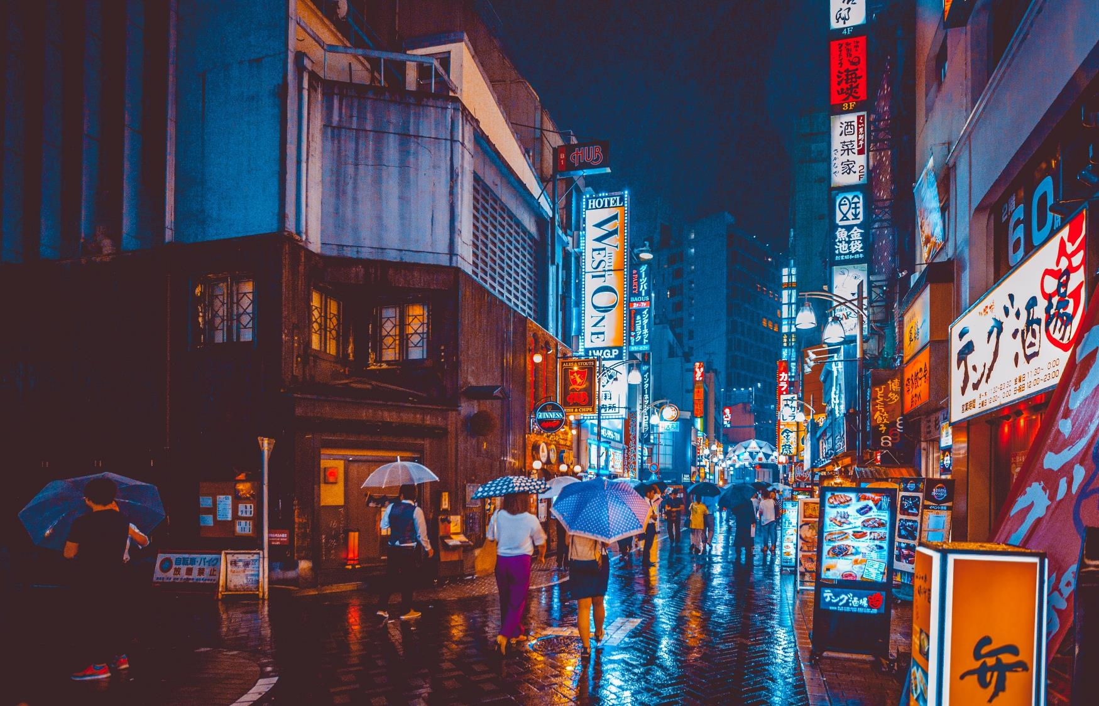
Battle of the Neighborhoods
Where to establish a Karaoke Bar

Slide 2
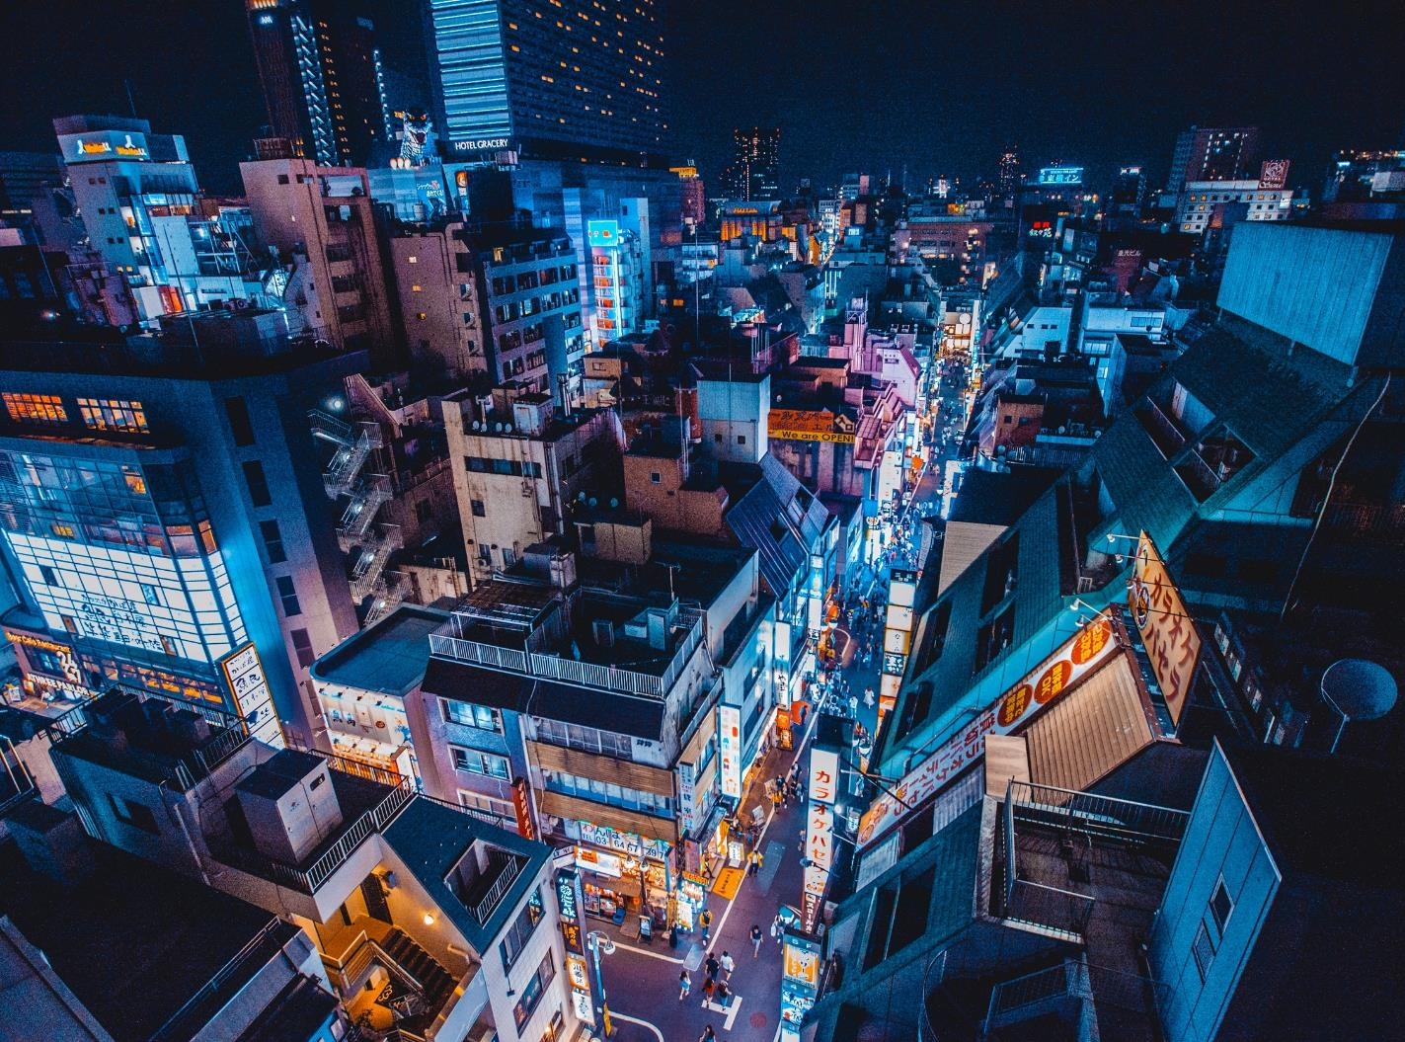
Introduction
A small investment company inquires where they should best allocate their resources to develop a Karaoke-themed bar. They are looking for an area where starting a new business will attract the right customers and generate the highest revenue. This problem is useful for any business looking to see which markets to develop a business in for various avenues.

Slide 3
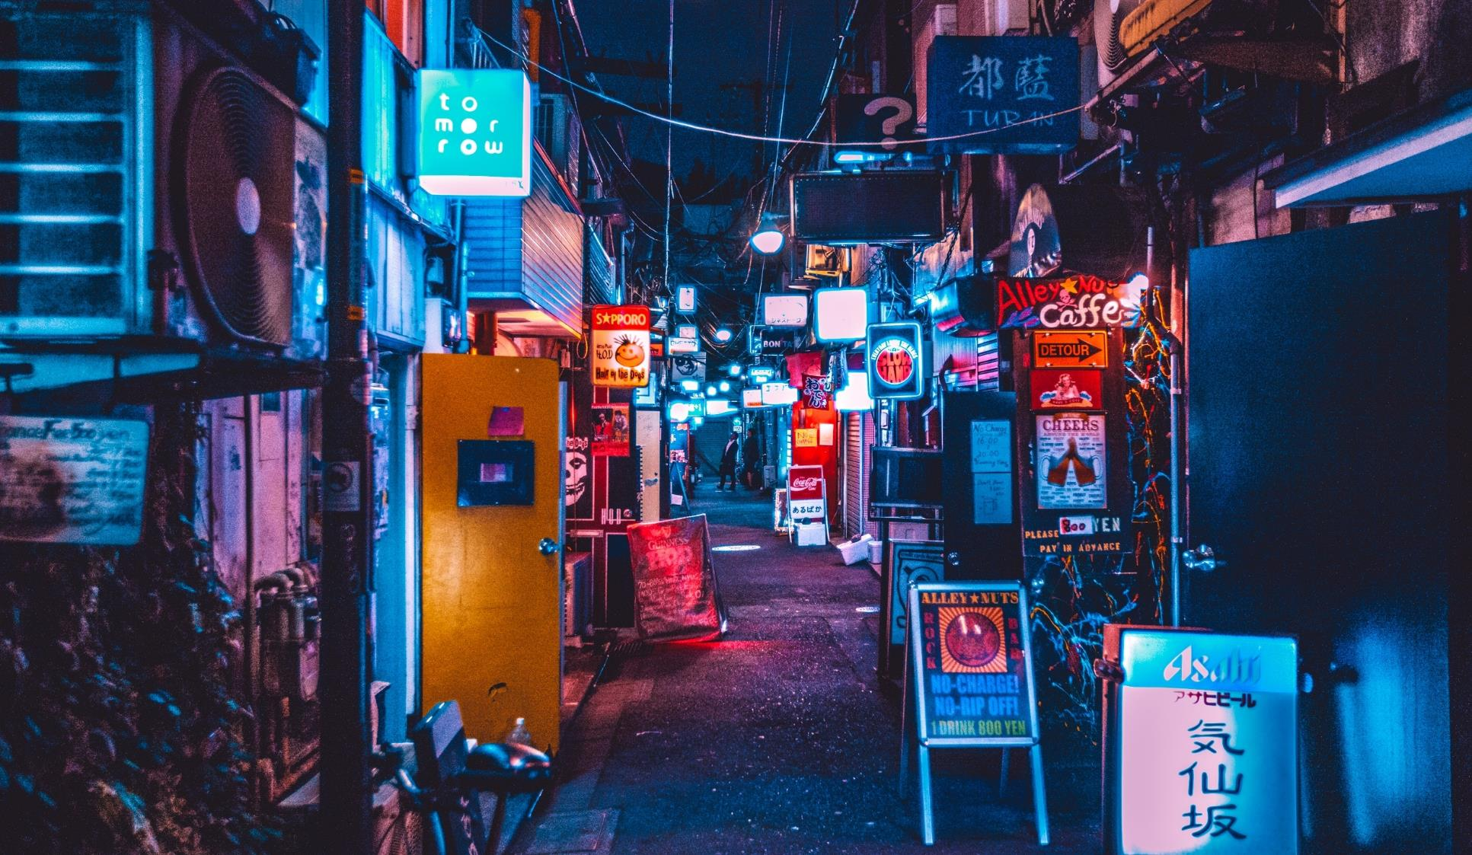
Business Problem
Determine the U.S. city with the most potential for revenue, fewer competitors
Focus on areas with highest population and per capita income (based on Wiki data)

Slide 4
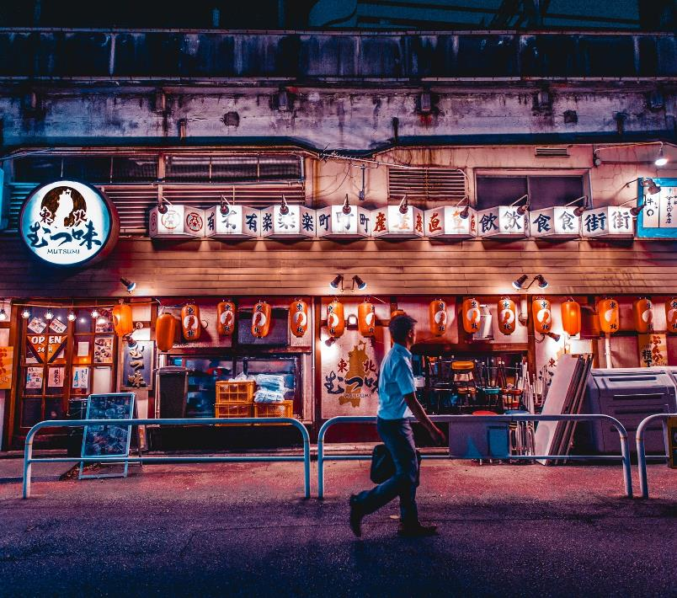
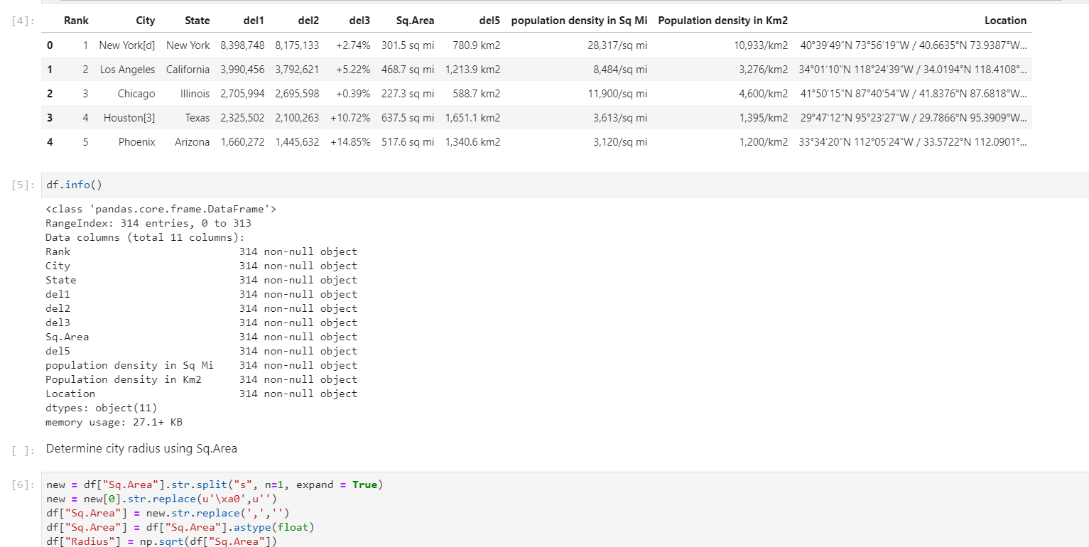
About the Data
List_of_United_States_cities_by_population was scraped using the BeautifulSoup library to build a pandas dataframe. The result data frame lists the cities, states, coordinates, area and population density (Table output below):
https://en.wikipedia.org/wiki/List_of_United_States_counties_by_per_capita_income:
The Wikipedia pages provide sufficient data for determing which location would best provideo potential returns for the Karaoke business

Slide 5
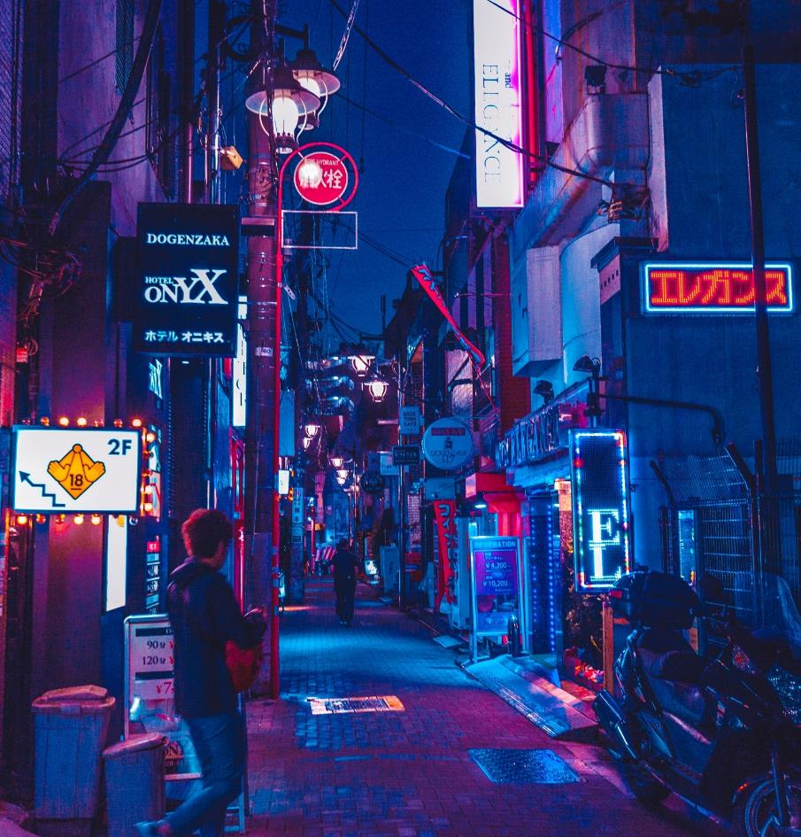
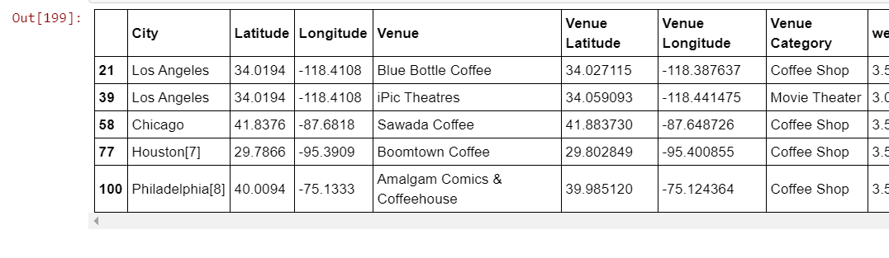
Methodology(s)
Similar to the Coursera lab, we used the Foursquare API to determine which city with geographical coordinates would best provide an answer to our business problem.
…and Based on our weight values (using sklearn) we determine the best location to be …

Slide 6
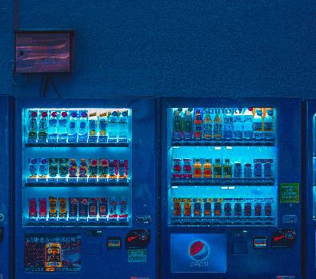
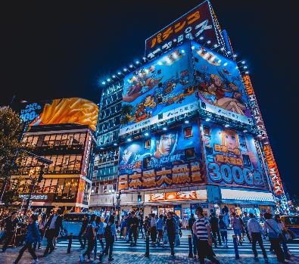
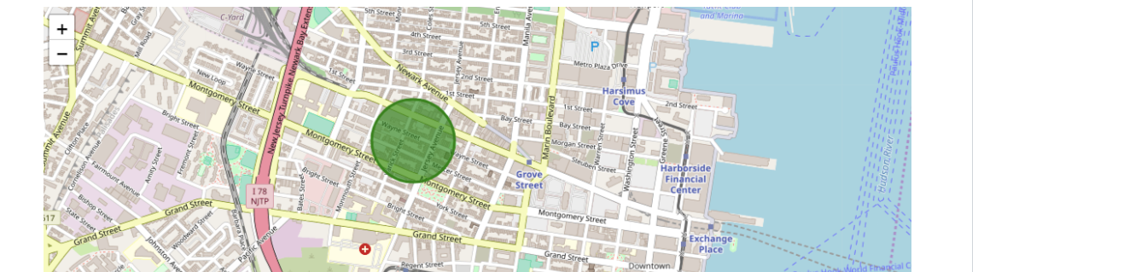

New Jersey
Using the Folium graphical output and weighted values we’ve determined the intersection of Grove and Grand Street to be the ideal location for the Karaoke business (given the API constraints, limited calls, etc.)

Slide 7
DISCUSSION
Where to go from here> Improvements
Observations
Improvements
Given the influx of people in the area and the sufficient per capita income, we can reliably suggest to the investment company to develop their karaoke business in that area.
If the Foursquare API allowed for more aggressive search results (> than 1000), we probably would not have choices limited to New Jersey.
Perhaps a different machine learning method could be implemented to make more efficient use of time and reliability (SVMs?).
Without API call restrictions, a different choice could have been discovered.

Slide 8
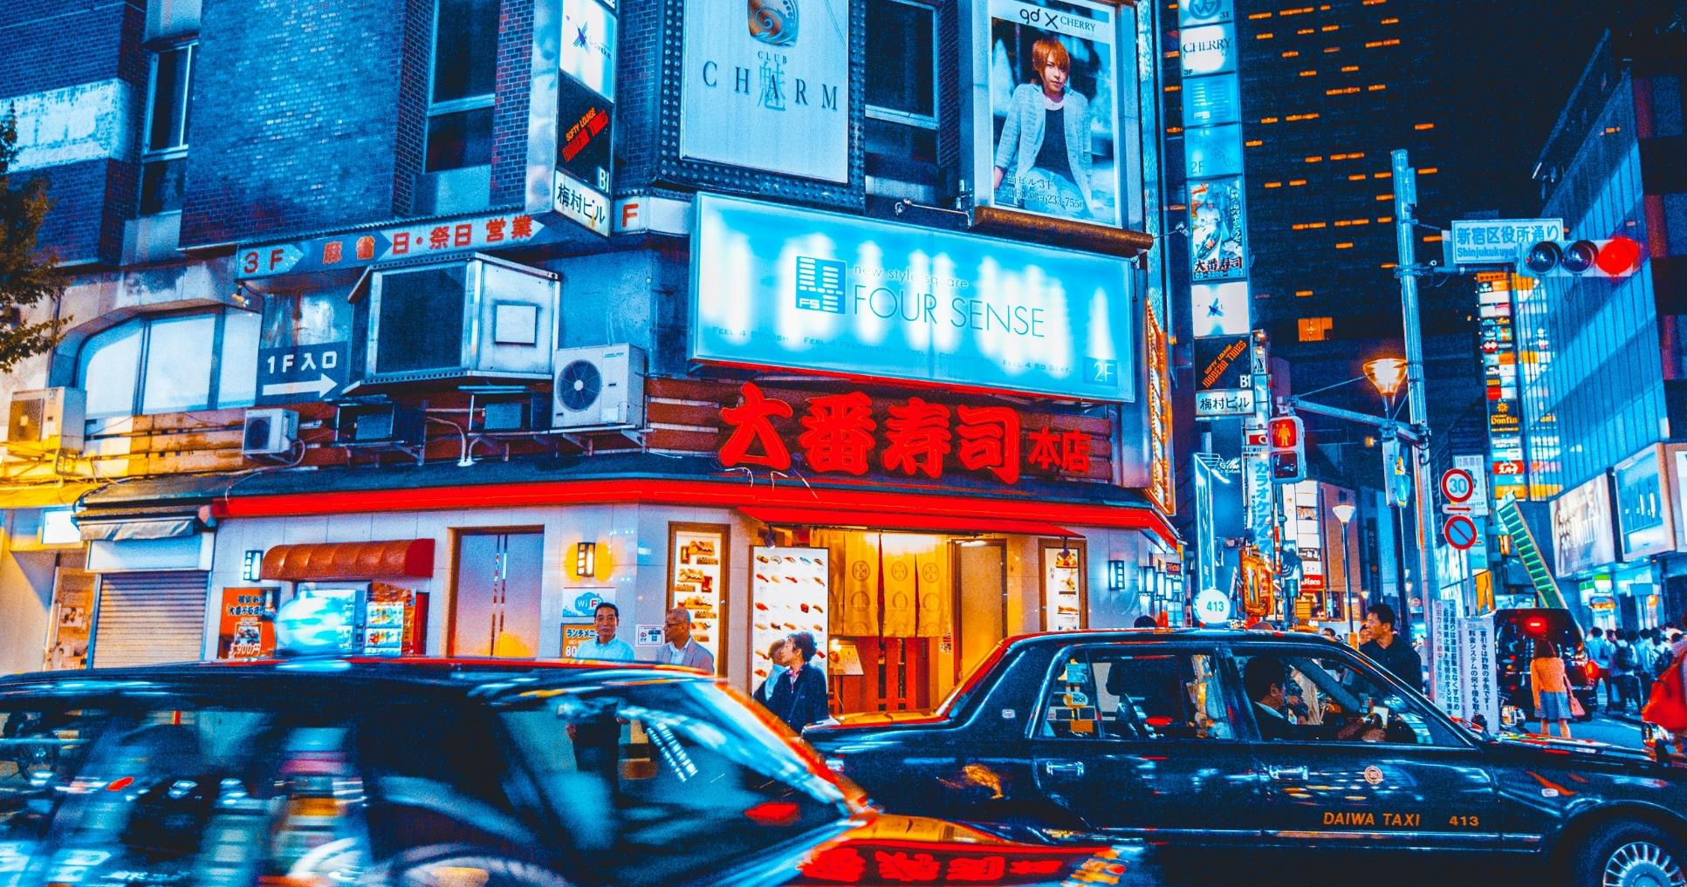
CONCLUSION
CONCLUSION
I would have liked to done the project with more API calls and a larger database, but regardless of the constraints, I think the investment company will be thrilled to not have to argue which location is best suitable for their karaoke business. Perhaps L.A. or San Francisco would provide a better locale, but perhaps not, given it already has plenty of karaoke bars and the cost to rent a business there would be harder to maximize profits. N.J. it is!

Slide 9

Thank You
IBM CAPSTONE

